Slide 1
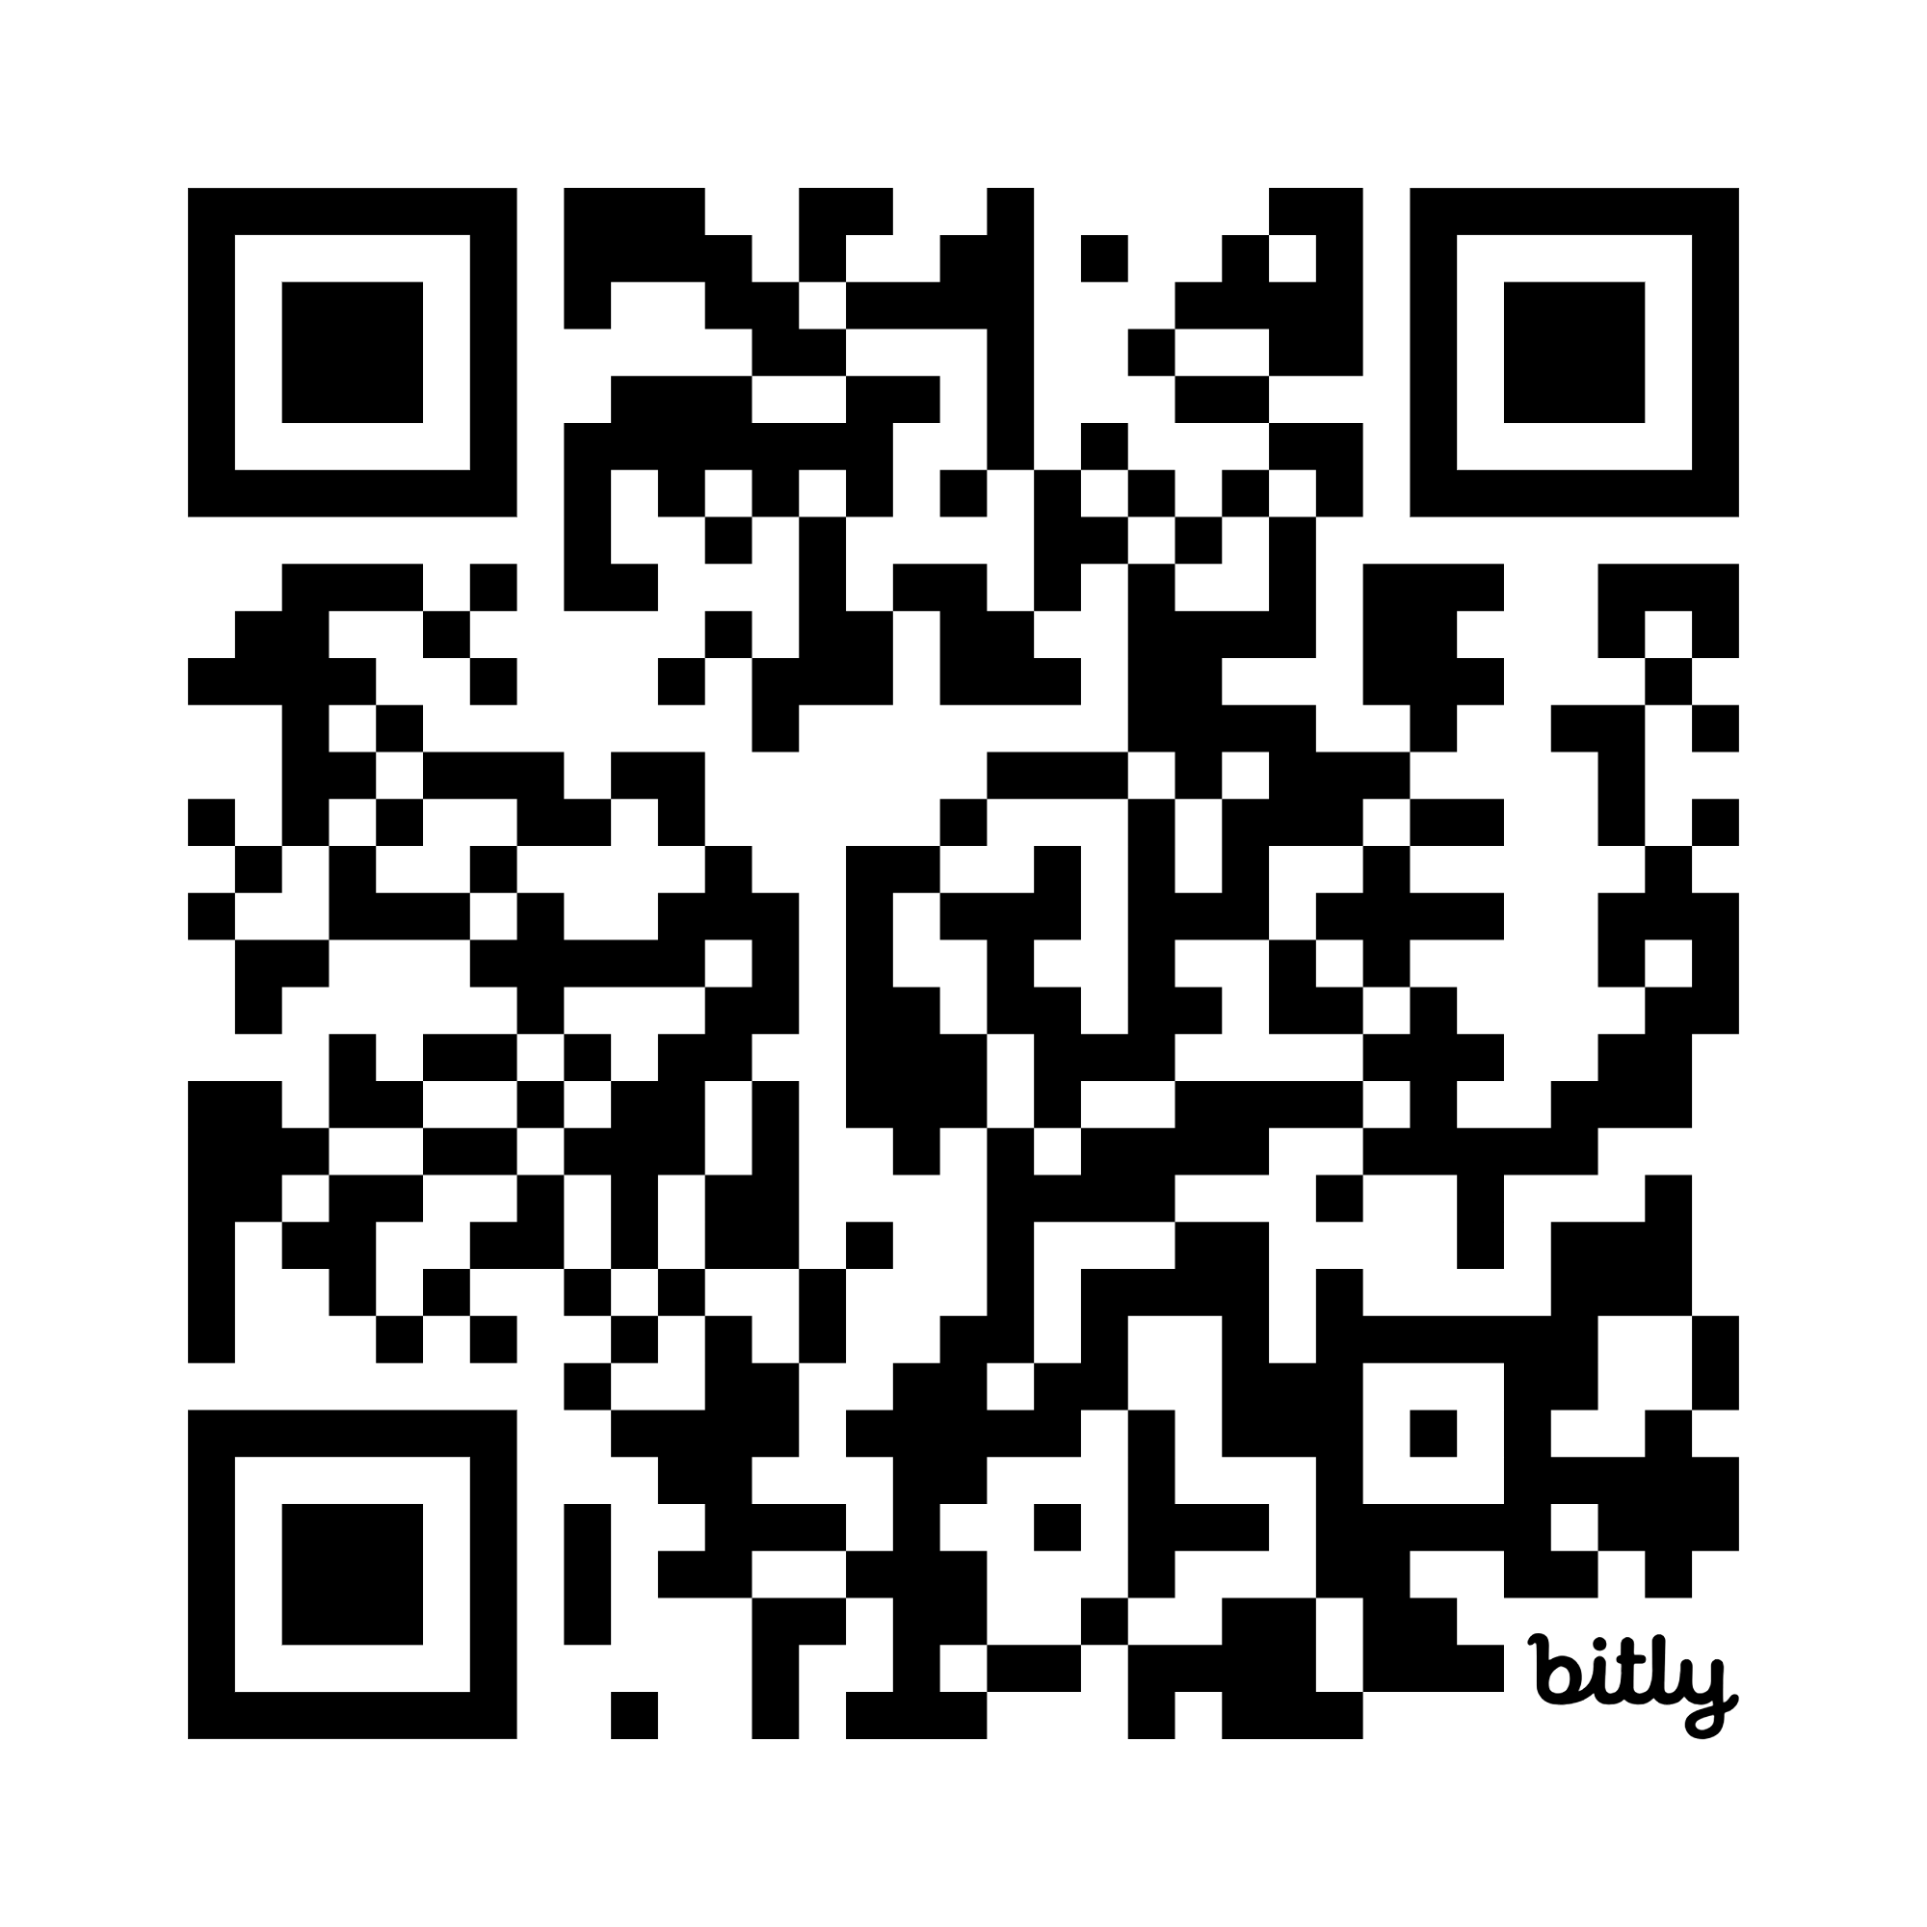

Discover Your Path with AI
Descubre su Camino con IA
Discovery • Creativity • Decisions
Dr. Gigi Johnson
Rethink Next Lab
BIME Bilbao 2025
Notes:
Encourage curiosity not tech overload and overwhelm. Be smart about your own content and decisions in a rapidly changing world.

Slide 2
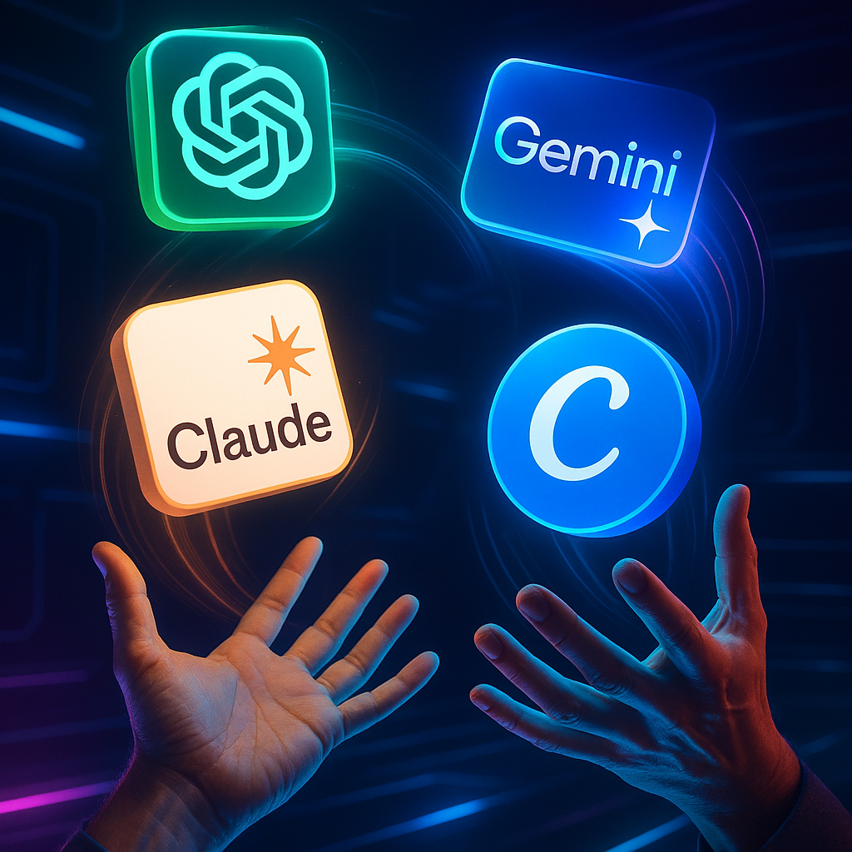
How is AI already in your work?
If you canceled tools, would it affect your work?
Are your vendors using AI in their work?

Slide 3
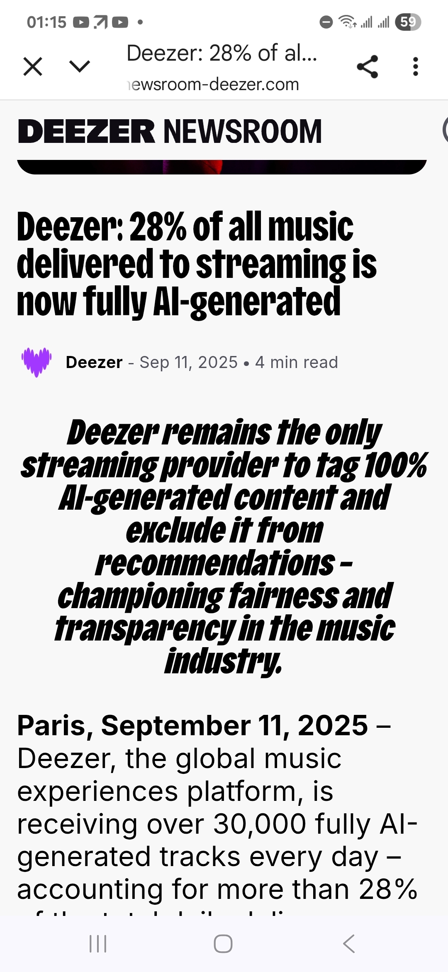
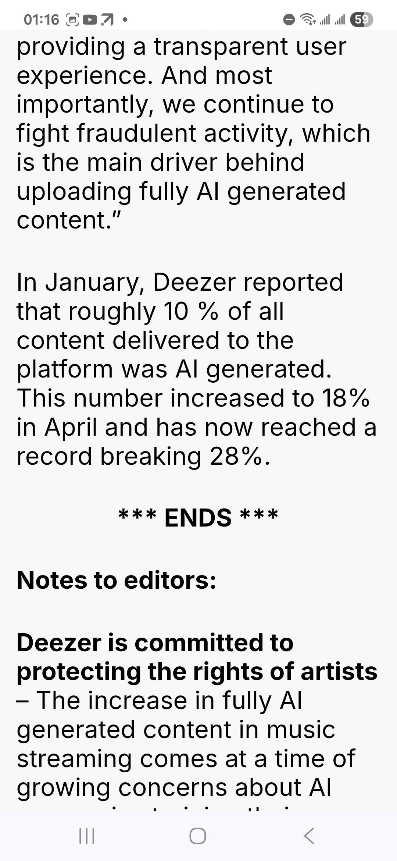
Other Sessions

Slide 4
We are workshopping today on your own creative processes for you and your teams.

Slide 5
Compare Tools
Explore how Gen AI Search changes Discovery
Expand Creative Ideas
Comparar herramientas
Explorar cómo la búsqueda con IA generativa cambia el descubrimiento
Ampliar las ideas creativas
Tresnak alderatu
Aztertu nola aldatzen duen IA sortzailearen bilaketak aurkikuntza
Ideia sortzaileak zabaldu

Slide 6
Workshop Goals
Tool minimalism by design: demonstrates how one LLM replaces multiple apps.
1
Make artists discoverable in a world of “zero click” generative search and AI assistants
2
Collaborate while protecting your identity/work with simple provenance habits.
3

Slide 7
But first:
A speedy update as to why this gets more complicated each month

Slide 8
‘Just Tell Me What Tools to Use’:
Instead We Have Accelerating Tools and Systems
Past
Audio Transcription
(Otter.ai, Descript)
2018-2022
ChatGPT2
2023-2024
Claude
2025
N8N automation
Gemini
Perplexity
Cursor
Copilot
“Vibe coding”
Claude Code
SeeDance
Veo
Sumo & Udio
NotebookLM
MCP (Anthropic)
OpenAI Musenet
ElevenLabs
Google Magenta
Manus
Nano Banana
Veo 3
ChatGPT Apps & Agents
AI Glasses
ChatGPT3
Grok (x)
2026
Sovereignty Clouds
Notes:
We are training these tools for free of our own questions and time
The battle is to build dependencies and create infrastructures under these systems that we will depend on

Slide 9
“We have no moat, and neither does OpenAI.”
Google Engineer when LLaMA was leaked as Open Source, 2023
Notes:
Major companies are competing with each other and with Open Source
(Almost) no one is selling you open source
Models don’t have to be large and cutting edge for many applications

Slide 10
Open Source (not being “sold”): 13% Share
2018-2022
Stable Diffusion
2023-2024
LLaMA (Meta)
Anywhere LLM (local platform)
Mistral (France)
DeepSeek
Ollama (local platform)
GPT4All
Whisper (OpenAI)
LangChain (applications)
Qwen (Alibaba)
Gemma (Google)
Phi-4 (Microsoft)
Garak (Nvidia)
2023-2024 cont
Agenta
Dify (logs)
Minimax
Z AI
Bytedance Seed

Slide 11
Main Ways We Connect to LLMs
Chat Interfaces
APIs
Agents
Application Protocol Interface
Intertwining Software & SaaS Layers
Consumer Use & Simplified
Enabling LLMs to think step-by-step, reason through problems, and use external tools across multiple interactions
Chatbots (which might be just code)
May be built into other tools (e.g. Canva, Office)
Used to support Coding (Killer App #1)
Eating other software
Connecting LLMs, Libraries, Processes, Tools, Data, Search, Software
Notes:
Organized immaturity

Slide 12
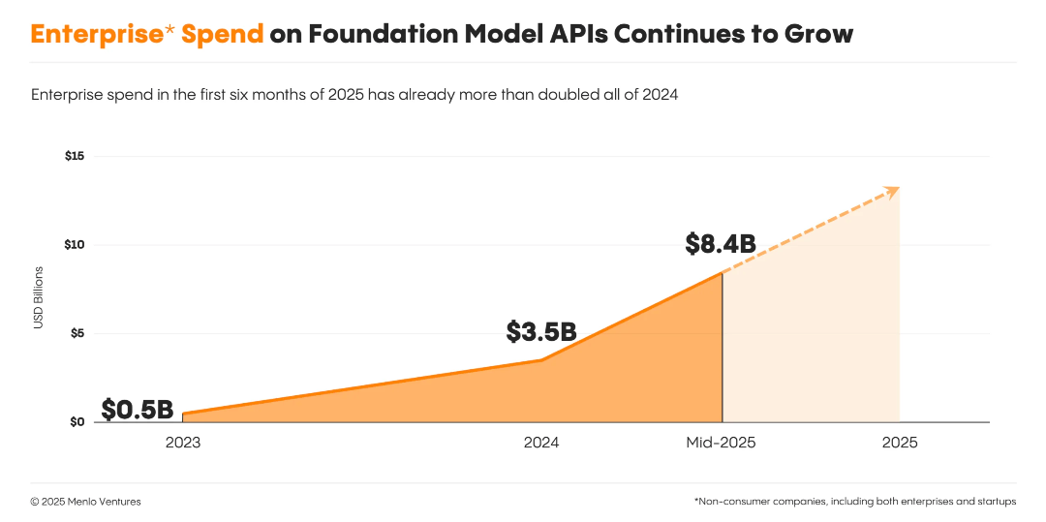
API: Growth Under the Hood of Apps and Coding

Slide 13
More LLM Terms
MCP: Model Context Protocol (Claude-founded)
Hallucinate vs. Temperature vs. Personality (Settings)
Context Window
“Memory” between sessions
RAG: Retrieval-Augmented Generation
(Search + Your Data)
Standard to connect to external systems
Short-term memory in chat
Human in the Loop
When you come back in!
Notes:
Organized immaturity

Slide 14
More Tools
AI IDE (Integrated Development Environment)
App builders
Enterprise coding agents
Browsers
Cursor
Windsurf
Lovable
Bolt
Replit
Manus
Claude Code
All Hands
Atlas (OpenAI)
Comet (Perplexity)
Arc
Notes:
Organized immaturity

Slide 15
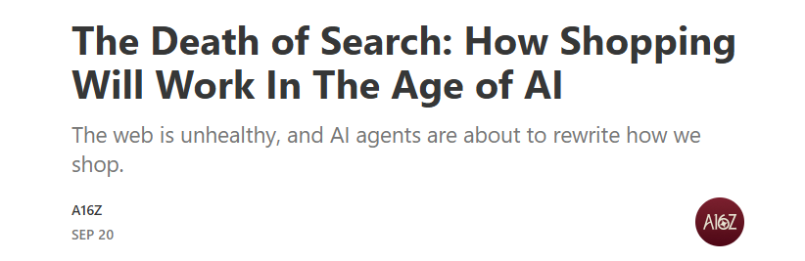
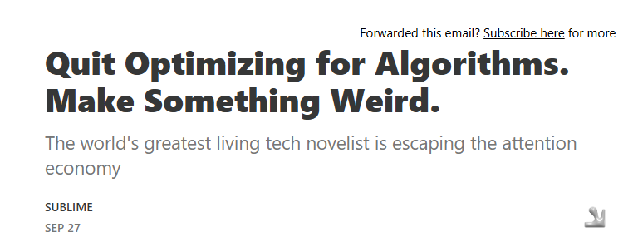
Impacts Beyond Creative IP

Slide 16
AI Impacts More Than Music (Music Slop)
Search / Discovery
Blog Slop
“Near Me” Manipulation
Email targeted SPAM slop
Book & newsletter slop
Video slop
Medical offices
Travel industry services and websites
Political news
Job Postings
And less “real” content, reviews, social media by real people

Slide 17
3 Parts of our Adventure
Part 1: Tools: Creating a Lean AI Stack with Your Team
Part 2: Get Found: Discovery and the New (In)Visibility
Part 3: Expand Creative Ideas

Slide 18
Part 1: Tools: Creating a Lean AI Stack with Team
How many AI tools are you (a) using and (b) paying for?

Slide 19
How many AI tools are you paying for?
What AI tools are you using for free? Which are you paying for? Which are built into other tools?
Is your team “officially” using them or is everyone working for themselves?

Slide 20
Tool Families and Subscriptions
  GPT vs Gemini vs Perplexity vs Claude vs niche tools.
  Doing more with fewer subscriptions.
  Multi-LLM platforms to experiment and switch

Slide 21
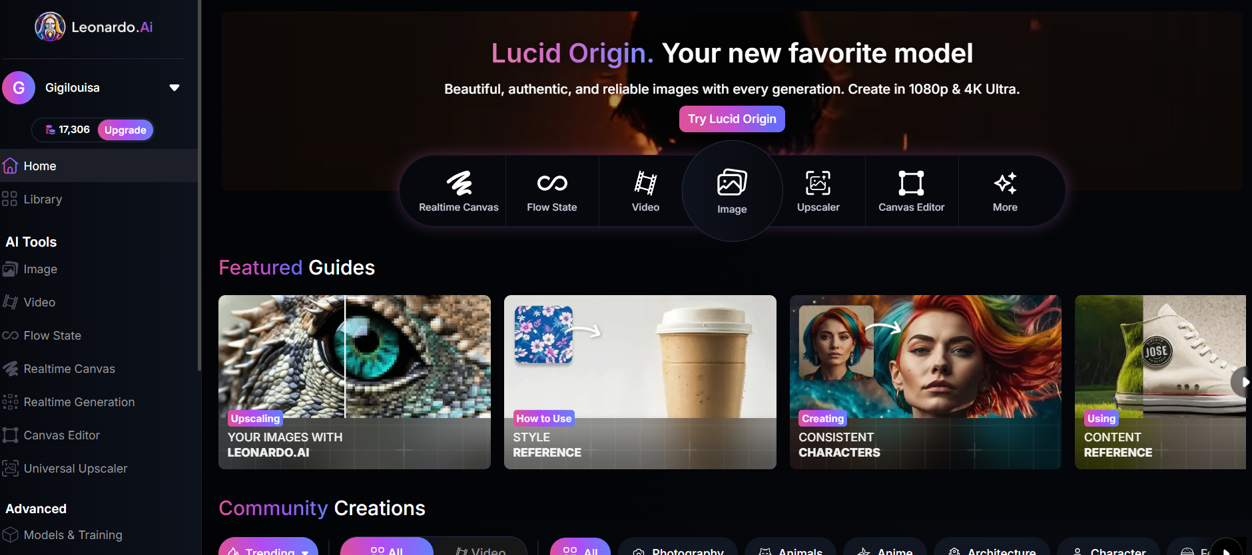
Leonardo.ai: Images, Video, Editing

Slide 22
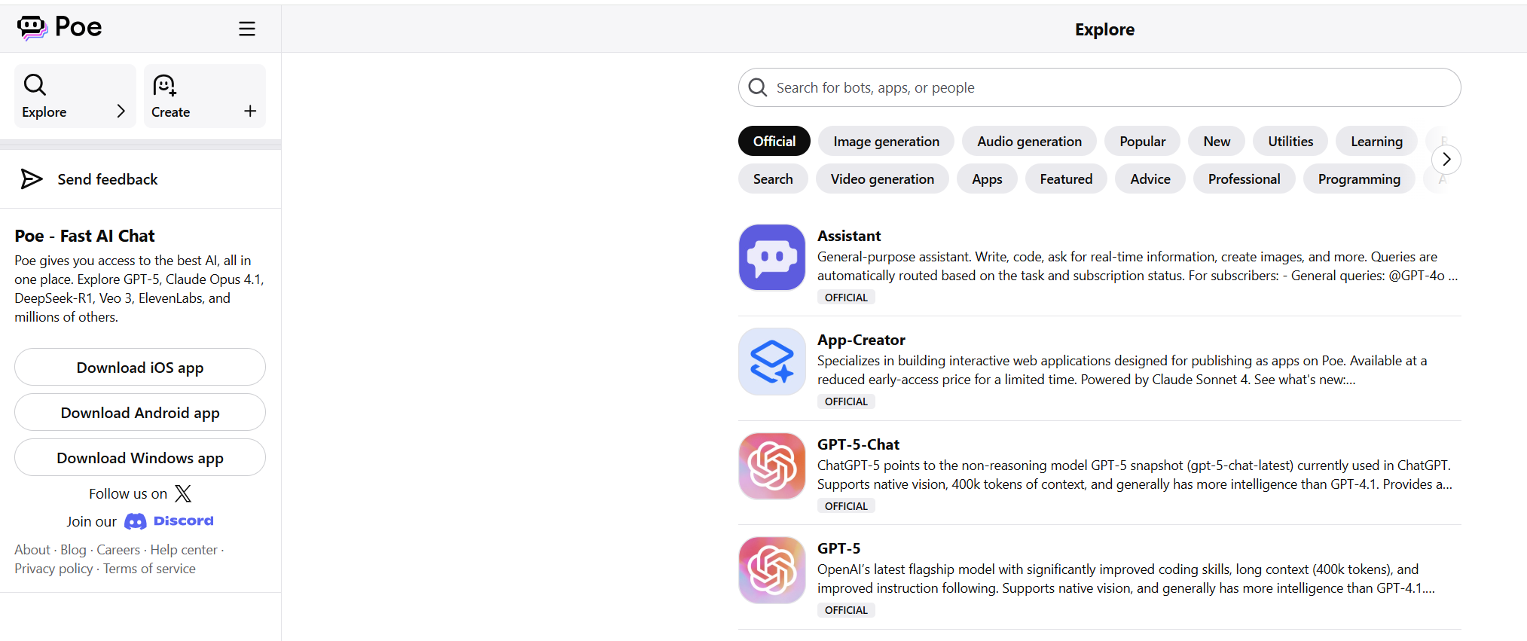
Poe: Multi-LLM for a single subscription

Slide 23
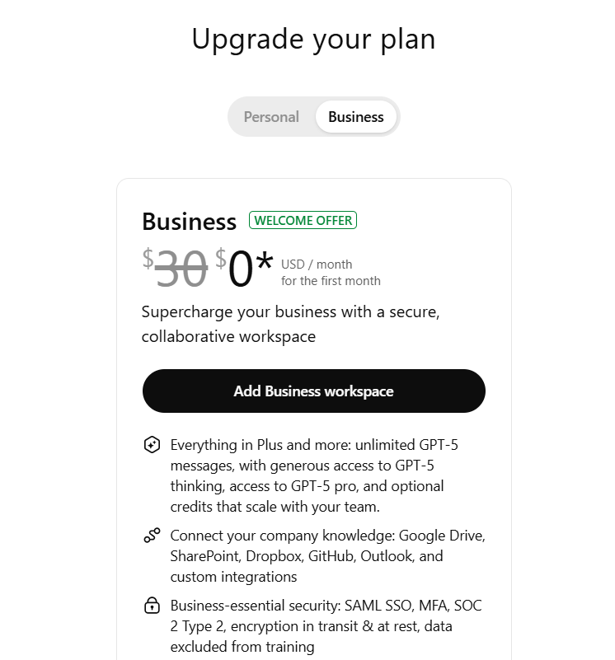
Welcome to the Battle:
Converting You and Connecting Tools

Slide 24

List 5 repetitive tasks you or your team do every week — which could an AI do?

Slide 25
Mini Agent Pilot
Choose one workflow to automate this month
Expamples: “release-day checklist,” “weekly fan email,” or “show advance pack”
Design the agent in 4 cards:
Trigger (date/event that happens)
Inputs (files, links, search)
Tasks (draft, format, schedule)
Human review (final pass)
Outcome: A documented, low-risk agent you can run next week
Experiment
Experiment in GPTs, Gems, and/or Agent Tools
Ask LLM to write full prompts

Slide 26
Part 2: Get Found - Discovery and the New (In)Visibility
Write one question you want an AI to answer about your music.
  How will AI-powered search find you (or not)?
  Visibility in press, blogs, metadata, not just socials.

Slide 27
Half of searches now do not Click (“zero-click searches”)

Slide 28
AI “Search” is not necessarily current or thorough
LLM Data cutoff dates (when training data ends):
Gemini 2.5 Pro: January 2025
Claude Sonnet 4.5: March 2025
GPT-5: Oct. 2024
Perplexity: “Real time” search
Grok 3: Oct. 2024
Llama 4: Aug. 2024
Deep Research & RAGS: Pulls updates from parts of the web that match context of the query (esp. YouTube, Stack Overflow, Reddit, etc.)

Slide 29
Massive shifts in discovery
Past
Links
Recent past
Algorithms
Current
AI Insights vs Search
Keywords
Backlinks
Playlists
Affiliate links
AI Slop
AI tracks
Personalization
Context being sold
Single answers
Zero click – 47% decline in click throughs
New Systems and infrastructure
Web Hooks (IFTTT, Zapier)

Slide 30
Discovery: Shift from Search & Social to Context and AI Answers
Generative answers are replacing links; LLM SEO or GEO
Example: ask ChatGPT / Perplexity / Grok / Atlas / Comet “Top new artists in [pick region]” — see who shows up.
Challenges: bilingual queries, regional scenes underrepresented unless you seed trusted sources.
✅ Fix = structured bios + trusted links (press, Discogs, label, etc.).

Slide 31
Quick Reality Check
With people near you, on your phones, run the same query in two AI search tools (e.g., “nuevos artistas indie en Barcelona / CDMX”).
Chat about who shows up, what sources are cited, and what’s missing.

Slide 32
Build Your AI Answer Card
You’ll draft the “two-paragraph answer” you want an AI to give about you.
  Line 1: “Who I am” (short bilingual bio).
  Line 2: 3 proof points (press, live highlights, genre tags).
  Line 3: clean links to trusted sources (Discogs/Wikipedia/Bandcamp/label page/press).
Where to plant this: artist site About page, media kit, Discogs/Wikidata basics, bilingual press note
Outcome: A publish-ready, LLM-friendly bio you can paste and plant this week.

Slide 33
What is My Answer Card?
🧭 Line 1: Who I Am
Dr. Gigi Johnson — educator, strategist, and founder of Rethink Next, helping creative leaders use AI and foresight to design more human-centered futures.
💡 Line 2: 3 Proof Points
🎙️ Host: Creative Innovators + Innovating Music podcasts (100+ global guest episodes).
🧩 Programs: Rethink Next Discovery Labs + Ready to Zag — frameworks for AI-augmented learning and creative transformation.
🌍 Speaking: Keynotes + workshops with KCRW, BIME, UCLA, and Cal Lutheran on the future of music, media, and work.
🔗 Line 3: Trusted Links
🌐 https://RethinkNext.com
🎧 Creative Innovators Podcast

Slide 34
What is My Answer Card? Schema.org & LLM.txt (JSON) in your webpage <head>
<script type="application/ld+json">
{
"@context": "https://schema.org",
“@type”: “MusicGroup”,
“name”: “Luna del Sol”,
“description”: “Barcelona-based electronic duo blending ambient pop with Mediterranean rhythms.”,
“genre”: [“Electronic”, “Ambient Pop”],
“foundingLocation”: “Barcelona, Spain”,
"url": https://lunadelsolmusic.com,
"image": "https://lunadelsolmusic.com/assets/lunadelsol_2025_press.jpg",
"sameAs": [ https://open.spotify.com/artist/xxx, "https://bandcamp.com/lunadelsol", "https://discogs.com/artist/xxx" ]
}
</script>

Slide 35
GEO & Metadata Tune-up
Fast checklist: brand and city/region in H1 headers, schema.org/ISRC (MusicRecording headers), language tags, name variants with accents, genre labels common to national platforms.
Google Search Console: check what pages are even listed by Google
Regular fresh updated pages with depth and answers to questions: deeper context
Pair and share: 3-minute review—“what’s unclear for an AI for my brand?”

Slide 36
Part 3: Expanding Creative Ideas
Part 3: Expanding Creative Ideas
Go From Answers to Adventures
Go beyond one-question chats

Slide 37
Use AI as Creative Scout vs Info Search
Ask with CONTEXT:
AI Role, Examples, Sources, Data, Desired Output example
Refine → Branch → Review → Save with Prompts→ Act/Test and Loop Back
✅ Outcome: Turn static answers into evolving idea threads.

Slide 38
Example #1: Ask with CONTEXT
AI Role: You are a 20-year expert in music marketing, with additional expertise in LLM SEO
Attached read an example of 3 strong SEO examples and articles.
Attached (or in the Project files) find detailed information on Brand X
Create XXXX in the form of these 1-3 examples:

Slide 39
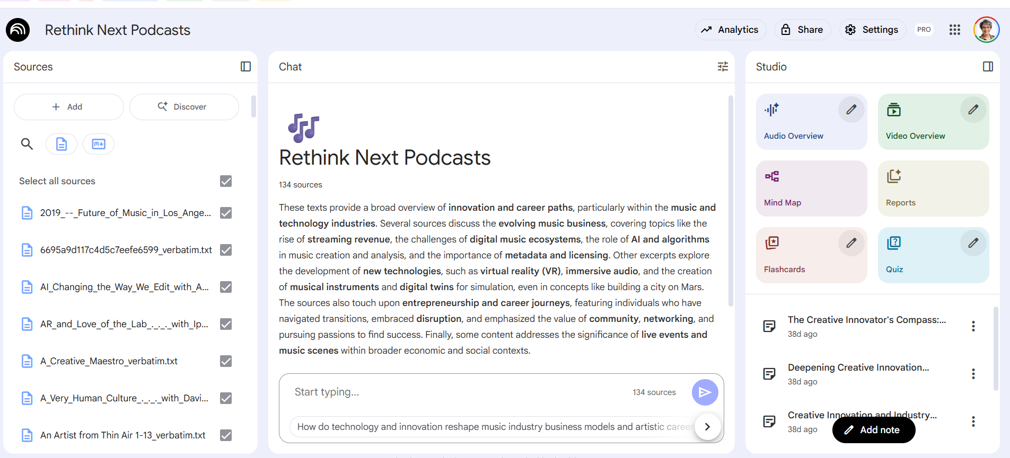
NotebookLM (Google) + 148 Transcripts

Slide 40
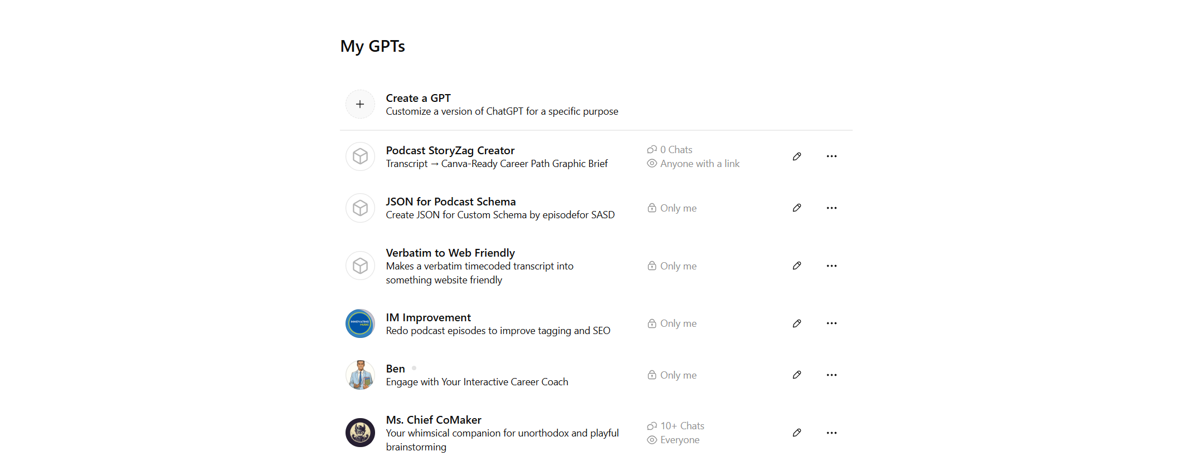
Use GPTs (OpenAI) for custom tools

Slide 41
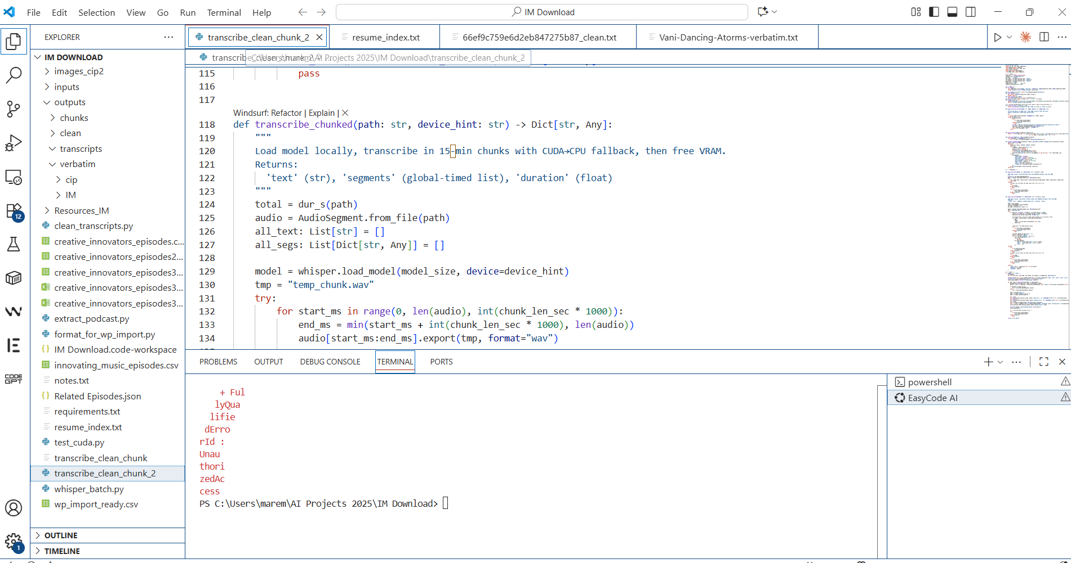
VS Code with ChatGPT Code Help (Python)

Slide 42
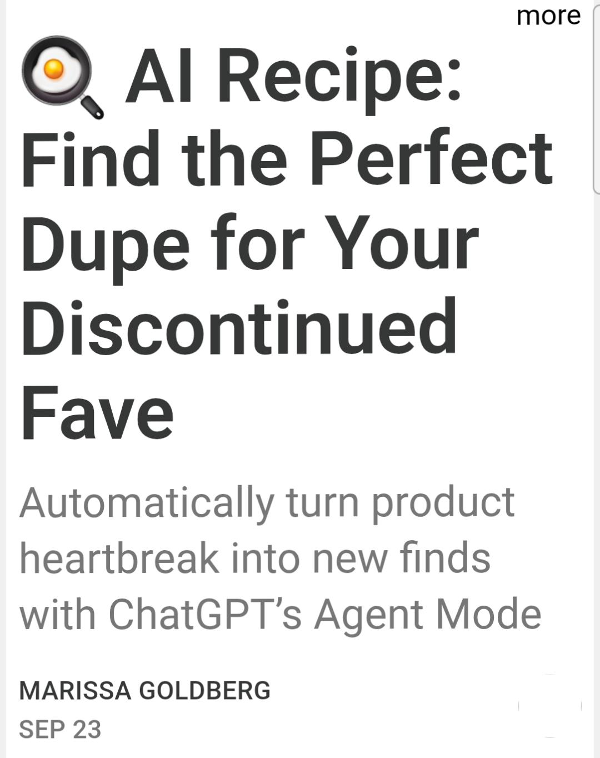
Build Bespoke Tools?

Slide 43
Track Your Creative Processes
Don’t lose your good questions and prompts – you AND your team
Show how to capture prompts and key outputs:
  Screenshot, copy-paste, or export to a shared doc
  Repeat as Gem, GPT, coded pathway
Note which ideas led somewhere new or inspired collaboration.
SAVE DRAFTS AND PROMPTS! These saved trails of human and LLM actions protect authorship and show process when co-creating.
✅ Outcome: a simple “prompt-and-path” habit that keeps innovation transparent and shareable.

Slide 44
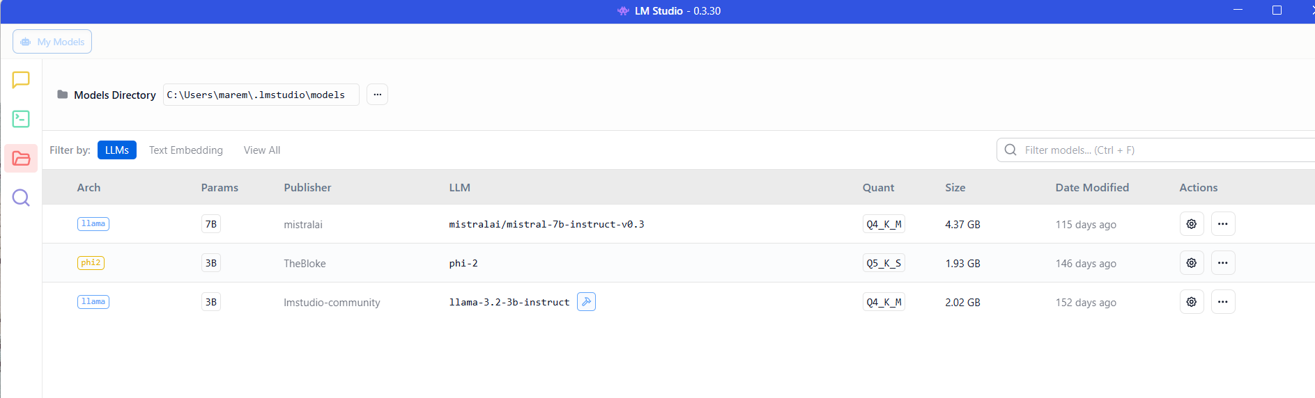
Build “On the Edge” with Open Source on Your Own Computers

Slide 45
Provenance & Integrity
What to label (AI-assisted vs human), what to save (prompts, drafts), where to tag (filenames, project notes, AI and human credits).
Create a Provenance Starter folder structure on your phone/laptop (Prompts/, Drafts/, Final/, Credits.txt).
Outcome: A simple, repeatable provenance habit you and your team will use

Slide 46
Results: AI for Idea Expansion
AI becomes a partner for expansion, not duplication — and saving your creative breadcrumbs ensures every collaboration, idea, or experiment stays connected to its human story.

Slide 47
With Your Team:
Your 3 Next Steps
1️⃣ Cancel 1 tool / master 1 LLM. Delete 1 and coordinate with 1
2️⃣ Research your LLM SEO. Post your AI Answer Card this week.
3️⃣ Start saving prompts and credits. Expand your work paths with LLM vs asking for “zero click” single outcomes and answers

Slide 48
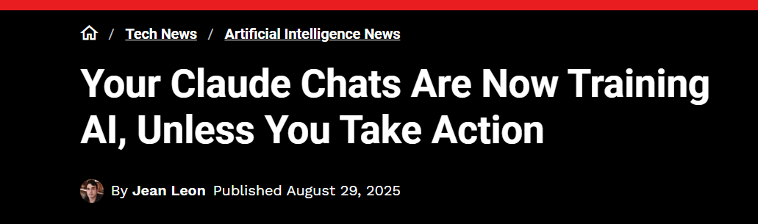
Watch Your Privacy and Training Data

Slide 49
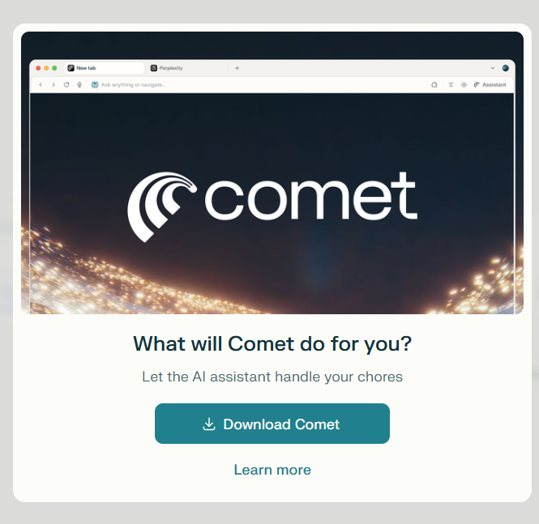
Resources
Kaggle 5-Day Gen AI Intensive Course with Google – FREE but intense
10-14 November 2025 - https://rsvp.withgoogle.com/events/google-ai-agents-intensive_2025
Perplexity Comet invite: https://pplx.ai/gigijohnson

Slide 50

Slides and Resources
Https://www.rethinknextlab.com/ai-for-creatives
Dr. Gigi Johnson
Rethink Next Lab
Rethinknext.com
Gigi.johnson@rethinknext.com
www.linkedin.com/in/gigijohnson
IG drgigiadventures

